Slide 1


Aditya Nema
30th July 2023

Slide 2

Outline
Executive Summary
Introduction
Methodology
Results
Conclusion
Appendix

Slide 3
Executive Summary
Summary of methodologies
Data Collection
Data Wrangling
EDA with data visualization
EDA with SQL
Build an interactive map with Folium
Building a Dashboard with Plotly Dash
Predictive Analysis
Summary of all results
Exploratory data analysis results
Interactive analysis.
Predictive analysis results

Slide 4
Introduction
In this analysis we will focus on the study of the first stage of the SpaceX Falcon9 Rocket in order to obtain conclusions that allow us to make cost projections as well as obtain insight on the implications in the area beyond the economic ones.
We will work on finding the following solutions:
How to predict if the rocket will land successfully.
What parameters can determine the success rate of a landing successful.
Project and determine the costs of future launches.

Slide 5

Section 1

Slide 6
Methodology
Data collection methodology:
Data was collecting from past SpaceX missions. SpaceX API
Web Scrapping from Wikipedia
Perform data wrangling
Calculated the number of launches on each site
Calculated number and occurrences of each orbit
Calculated the number and occurrence of mission outcome per orbit type
Created a landing outcome label from Outcome column
Perform exploratory data analysis (EDA) using visualization and SQL
Perform interactive visual analytics using Folium and Plotly Dash
Perform predictive analysis using classification models

Slide 7
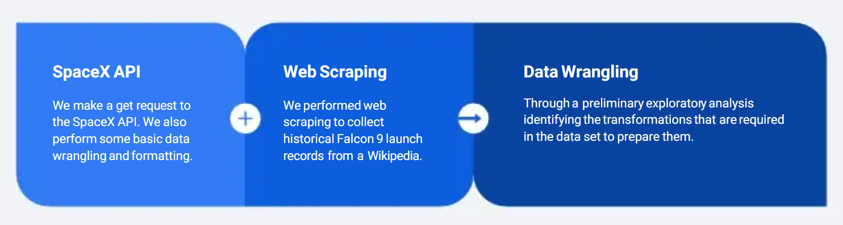
Data Collection
Data sets were collected from previous SpaceX mission and Wikipedia pages and below processes were obtained to Filter, clean and Transform the data to prepare for Modeling

Slide 8
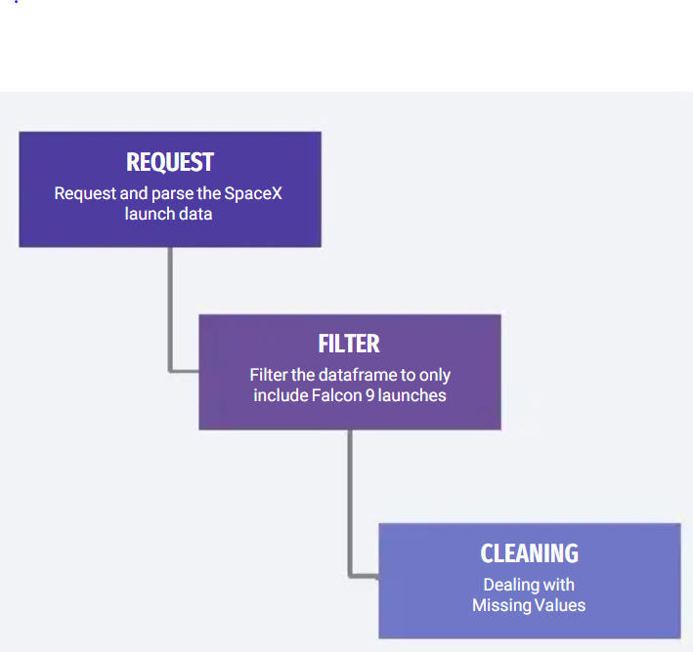
Data Collection – SpaceX API
We make a get request to the SpaceX API. We also perform some basic data wrangling and formatting.
It can be seen in detail in the following- https://github.com/adityanema91/data-science-capstone-coursera/blob/main/jupyter-labs-spacex-data-collection-api.ipynb

Slide 9
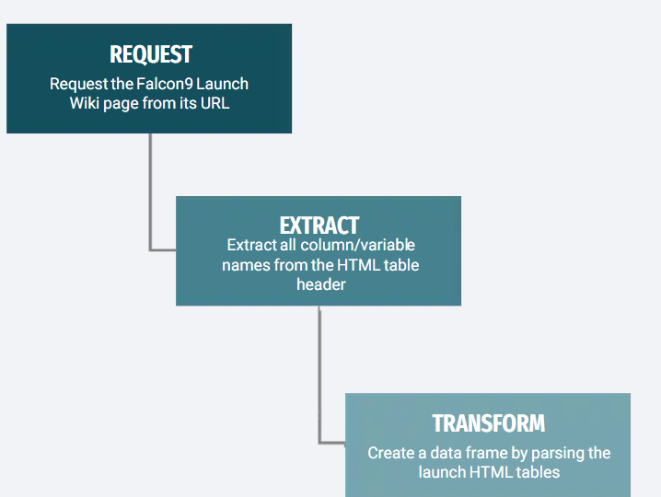
Data Collection - Scraping
We performed web scraping to collect historical Falcon 9 launch records from a Wikipedia page titled “List of Falcon 9 and Falcon Heavy launches”.
It can be seen in detail in the following- https://github.com/adityanema91/data-science-capstone-coursera/blob/main/jupyter-labs-webscraping.ipynb

Slide 10
Data Wrangling
Through a preliminary exploratory analysis identifying the transformations that are required in the data set to prepare them
We will process the landing data into valid tags for training the predictive models later.
Training tags with "1" will mean the rocket landed successfully and "0" means it was unsuccessful.
See in detail in GitHub link

Slide 11
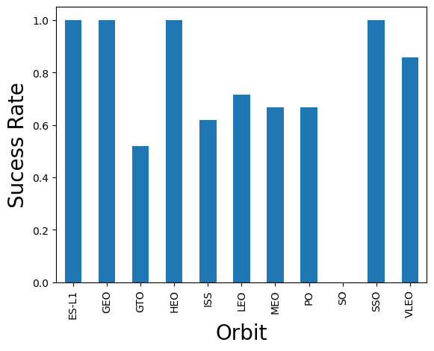
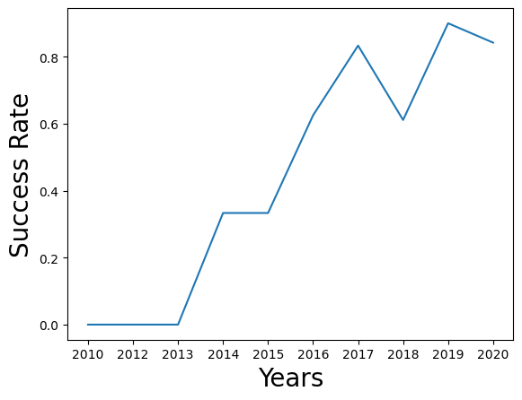
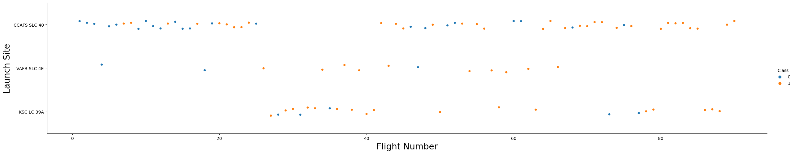
EDA with Data Visualization
Exploratory Data Analysis to visualize the relationship between:
Flight Number and Launch Site.
Payload and Launch Site.
Success rate of each orbit type.
Flight Number and Orbit type.
Payload and Orbit type.
Visualize the launch success yearly
See in details in link

Slide 12
EDA with SQL
SQL Queries performed-
Names of the unique launch sites in the space mission
Top 5 launch sites whose name begin with the string 'CCA’
Total payload mass carried by boosters launched by NASA (CRS)
Average payload mass carried by booster version F9 v1.1
Date when the first successful landing outcome in ground pad was achieved
Names of the boosters which have success in drone ship and have payload mass between 4000 and 6000 kg
Total number of successful and failure mission outcomes
Names of the booster versions which have carried the maximum payload mass
Failed landing outcomes in drone ship, their booster versions, and launch site names for in year 2015
Rank of the count of landing outcomes (such as Failure (drone ship) or Success(ground pad)) between the date 2010-06-04 and 2017-03-20
See details in link

Slide 13

Build an Interactive Map with Folium
Markers, circles, lines and marker clusters were used with Folium Maps.
Indications of each element:
Markers indicate points like launch sites
Circles indicate highlighted areas around specific coordinates like NASA Johnson Space Center
Marker clusters indicates groups of events in each coordinate like launches in a launch site
Lines are used to indicate distances between two coordinates.
See details in link

Slide 14
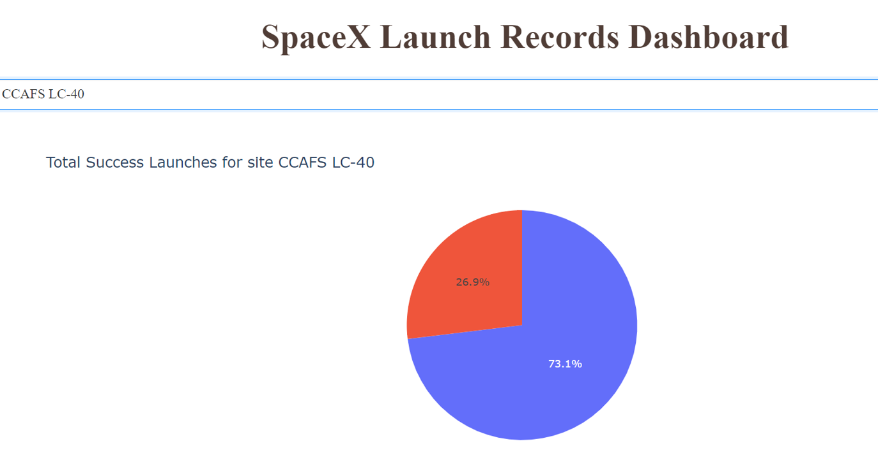
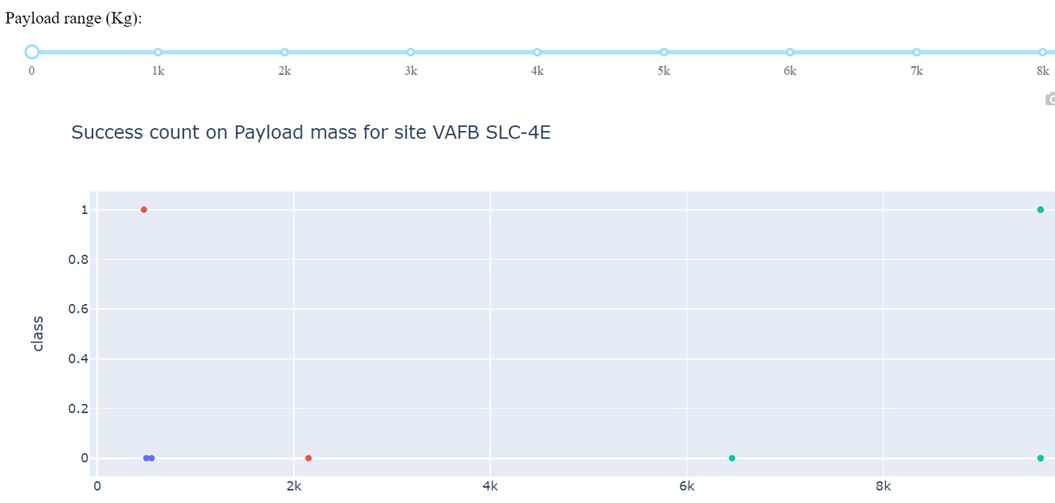
Build a Dashboard with Plotly Dash
Elements
Dropdown list for the launch site.
Range Slider for selecting the payload mass.
PieChart: for showing the success rate of each launch site, or showing the number of successful landing outcomes.
Scatterplot: Show success/failure by payload and booster version.
Findings:
Which site has the largest successful launches? KSC LC-39A.
Which site has the highest launch success rate? KSC LC-39A (success rate76.9%).
Which payload range(s) has the highest launch success rate? 2000-4000.
Which payload range(s) has the lowest launch success rate? 6000-8000.
Which F9 Booster version (v1.0, v1.1, FT, B4, B5, etc.) has the highest.
launch success rate? B5 (only one successful start), apart from that FT (15successes, 8 failures)
Dashboard
LINK FOR CODE

Slide 15
Predictive Analysis (Classification)
We create a machine learning pipeline to predict if the first stage will land given the data from the preceding labs
Perform exploratory Data Analysis and determine Training Labels
Create a column for the class
Standardize the data
Split into training data and test data
Find best Hyperparameter for SVM, Classification Trees and Logistic Regression
Find the method performs best using test data.
GitHub URL- link

Slide 16
Results
Exploratory data analysis results
Launch success rate increases over time
Higher success rate for higher orbits
Interactive analytics demo in screenshots
Higher success rate for higher payload mass
Low success rate for booster versions v1.0, v1.1, high success rate for FT, B4, B5
Higher success rate for Kennedy Space center and recent starts at CapeCanaveral
Predictive analysis results
Best prediction results with KNN and Support Vector Machine

Slide 17

Section 2

Slide 18
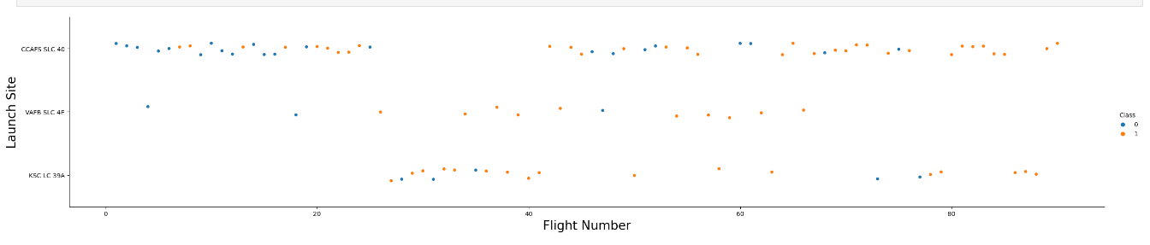
Flight Number vs. Launch Site
Explanations
We can see that the CCAFS LC-40 launch site has more attempts than KSC LC-39A and VAFB SLC 4E.We cansee that the CCAFS LC-40 launch site has more attempts than KSC LC-39A and VAFB SLC 4E.

Slide 19
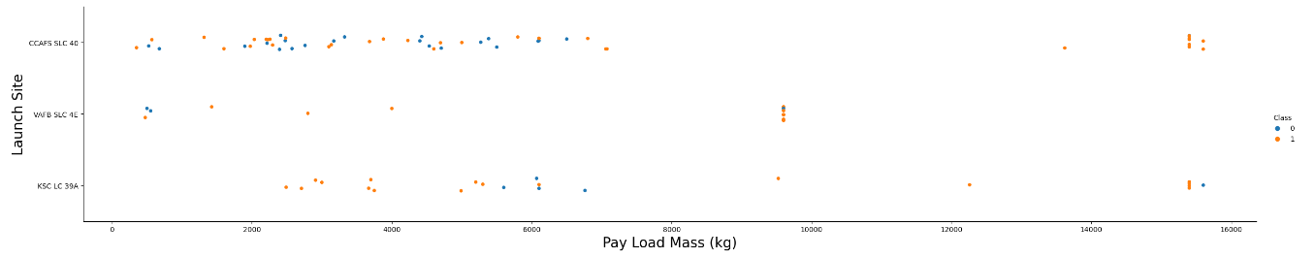
Payload vs. Launch Site
Explanation
Now if you observe Payload Vs. Launch Site scatter point chart you will find for the VAFB-SLC launchsite there areno rockets launched for heavypayload mass(greater than 10000).

Slide 20
Success Rate vs. Orbit Type
Explanations
Low Earth Orbits-GTO; ISS; LEO; MEO; PO; VLEO
High Earth Orbits- ES-L1; GEO; HEO;SSO

Slide 21
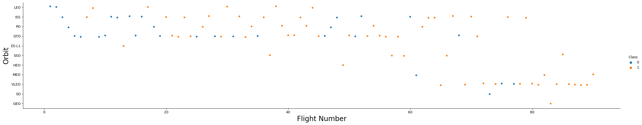
Flight Number vs. Orbit Type
Explanations
You should see that in the LEO orbit the Success appears related to the number of flights; on the other hand, there seems to be no relationship between flight number when in GTO orbit.

Slide 22
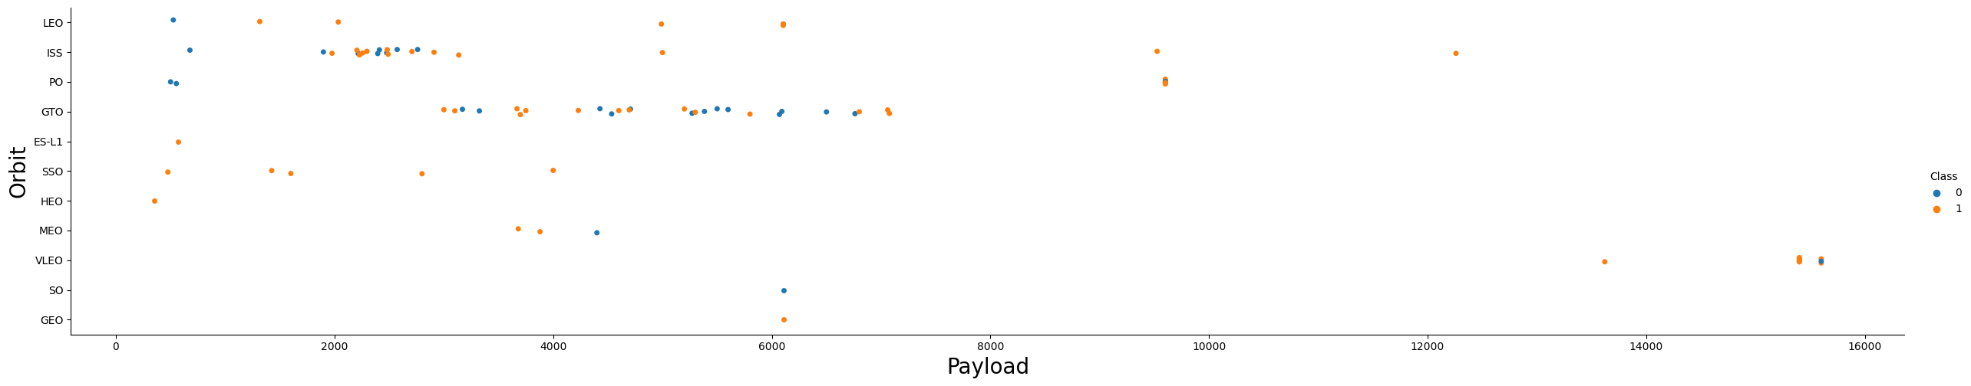
Payload vs. Orbit Type
Explanations
With heavy payloads the successful landing or positive landing rate are more for Polar,LEO and ISS. However for GTO we cannot distinguish this well as both positive landing rate and negative landing(unsuccessful mission) are both there here

Slide 23
Launch Success Yearly Trend
Explanations
you can observe that the success rate since 2013 kept increasing till 2020

Slide 24
All Launch Site Names
Unique Launch Sites-
CCAFS LC-40
VAFB SLC-4E
KSC LC-39A
CCAFS SLC-40
None
Query

Slide 25
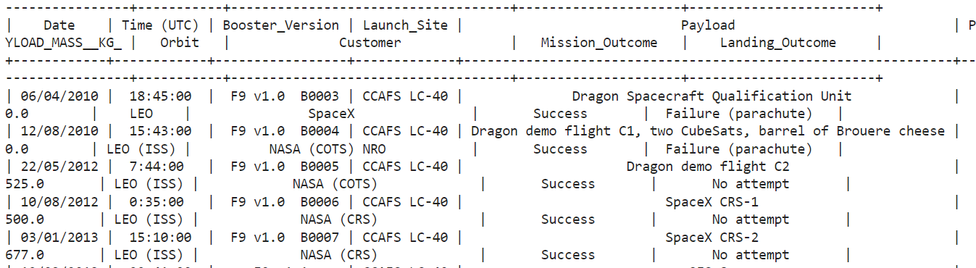
Launch Site Names Begin with 'CCA'
5 records where launch sites begin with the string 'CCA'CCAFS LC-40
Query

Slide 26
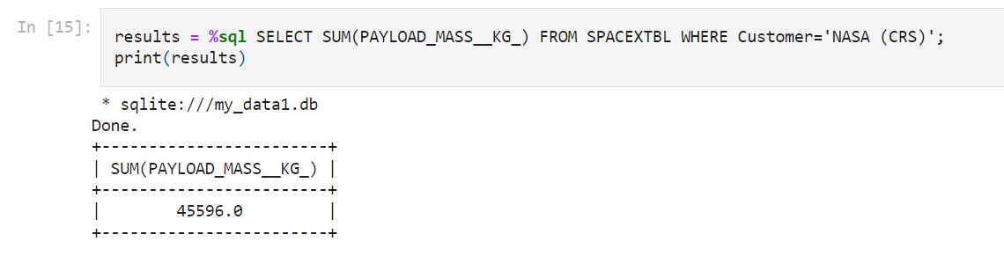
Total Payload Mass
Total payload carried by boosters from NASA-
45596.0 Kg
Query

Slide 27
Average Payload Mass by F9 v1.1
Average payload mass carried by booster version F9 v1.1
340
Query
%sql SELECT AVG(PAYLOAD_MASS__KG_) FROM SPACEXDATASET WHERE Booster_Version LIKE 'F9 v1.0%';

Slide 28
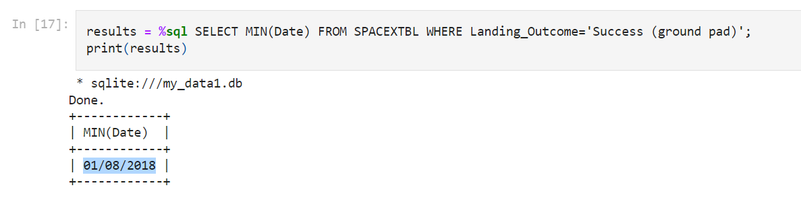
First Successful Ground Landing Date
Dates of the first successful landing outcome on ground pad
01/08/2018
Query

Slide 29
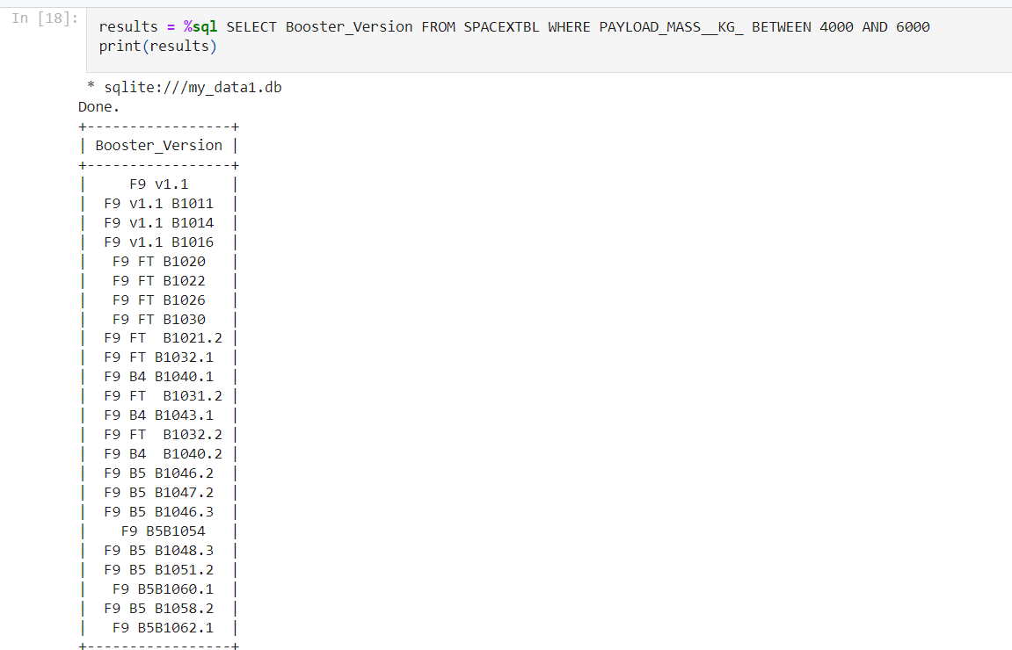
Successful Drone Ship Landing with Payload between 4000 and 6000
names of boosters which have successfully landed on drone ship and had payload mass greater than 4000 but less than 6000

Slide 30
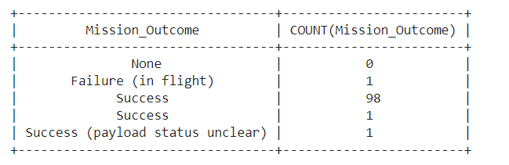
Total Number of Successful and Failure Mission Outcomes
Total number of successful and failure mission outcomes
Query

Slide 31
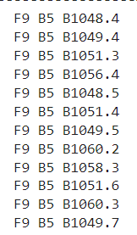
Boosters Carried Maximum Payload
Names of the booster which have carried the maximum payload mass
Query

Slide 32
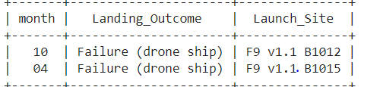
2015 Launch Records
Failed landing outcomes in 2015
Present your query result with a short explanation here

Slide 33
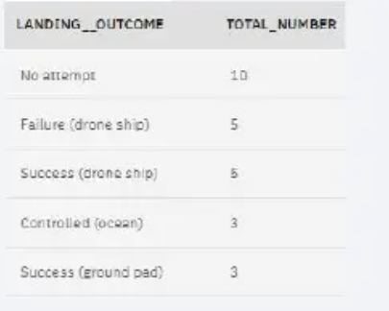
Rank Landing Outcomes Between 2010-06-04 and 2017-03-20
Rank the count of landing outcomes (such as Failure (drone ship) or Success (ground pad)) between the date 2010-06-04 and 2017-03-20, in descending order
Query
%%sqlSELECT LANDING__OUTCOME, COUNT(LANDING__OUTCOME) AS TOTAL_NUMBER FROM SPACEXDATASETWHERE DATE BETWEEN '2010-06-04' AND '2017-03-20' GROUP BY LANDING__OUTCOMEORDER BY TOTAL_NUMBERDESCRank Landing Outcomes Between 2010-06-04 and 2017-03-20

Slide 34

Section 3

Slide 35
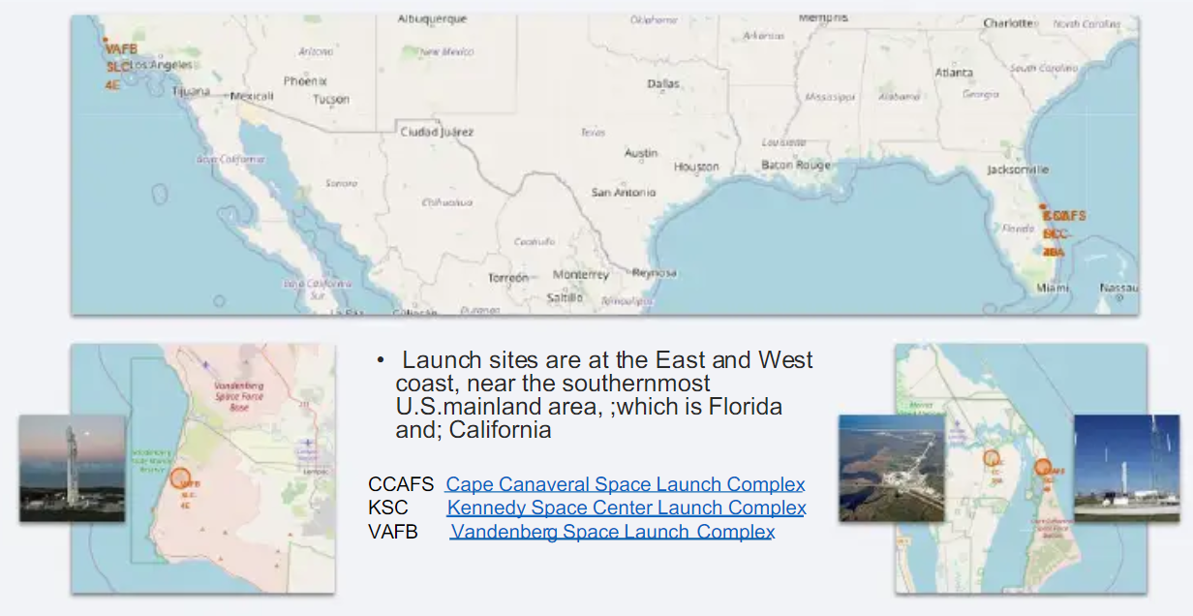
Folium Map- Launch Sites

Slide 36
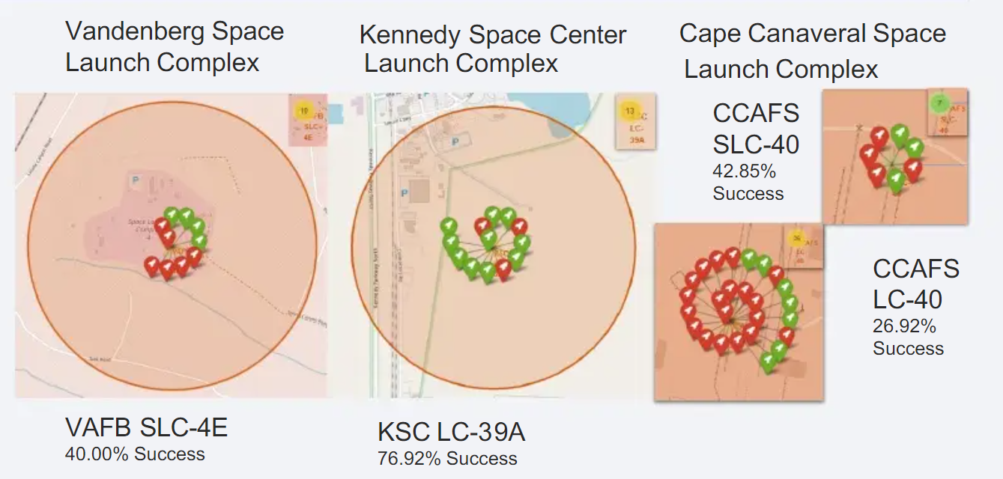
Folium Map- Stage 1 Landing success

Slide 37
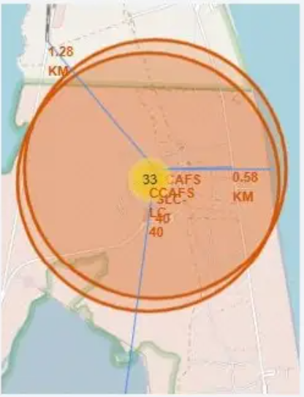
Folium Map- Logistics
Launch site KSC LC-39A has good logistics aspects, being near railroad and road
Also it is far from inhabited areas

Slide 38

Section 4

Slide 39
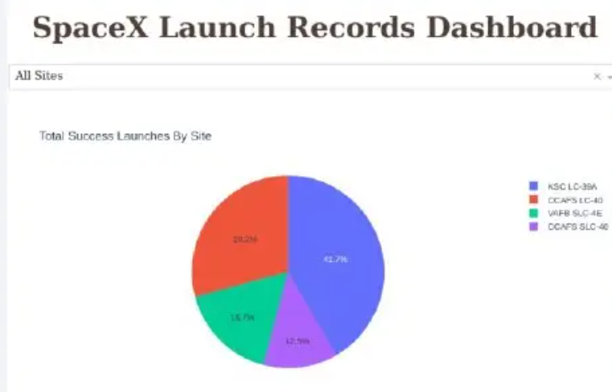
Dashboard- Success for all sites
Kennedy Space Center (KSCLC-39A) hast the most successful stage-1 landings
Vandenberg Air Force Base(VAFB SLC-4E) has the least number of successful stage-1landings

Slide 40
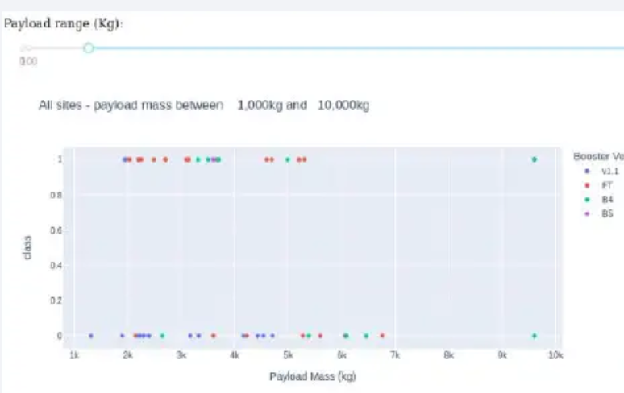
Dashboard- Payload vs launch outcome
Payloads under 6,000kgand FT boosters are the most successful combination.

Slide 41
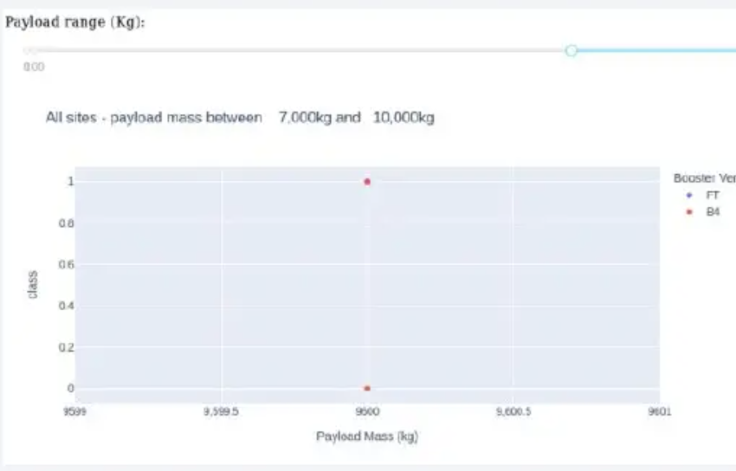
Payload vs launch Outcome
There’s not enough data to estimate risk of launches over7,000kg

Slide 42

Section 5

Slide 43
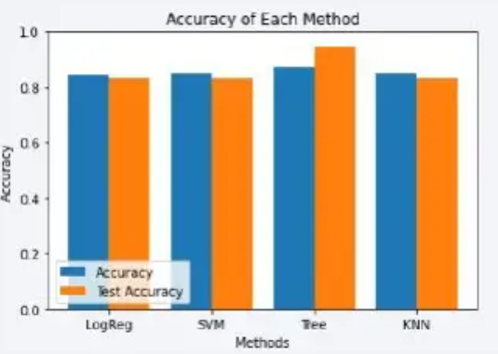
Classification Accuracy
Four classification models were tested and their accuracies are plotted beside
The model with the highestclassification accuracy is Decision TreeClassifier, which has accuracies overthan 87%

Slide 44
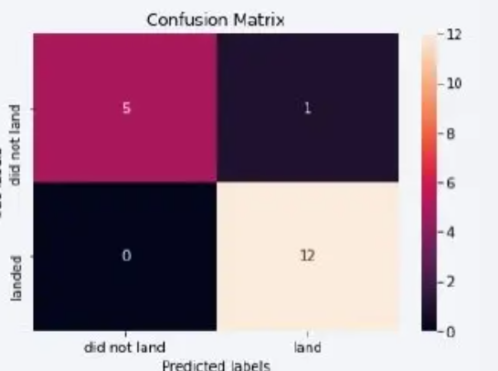
Confusion Matrix
Confusion matrix of Decision Tree Classifier proves its accuracy by showing the big numbers of true positive and true negative compared to the false ones.
True Positives | 12
True Negatives | 5
False Positives | 1
False Negatives | 0

Slide 45
Conclusions
The best launch site is KSC LC-39A
Launches above 7,000kg are less risky
Although most of mission outcomes are successful, successful landing outcomes seem to improve over time, according the evolution of processes and rockets
None of the models had false negatives
All models had at least one false positive
Prediction with Logistic Regression is quite accurate•
Support Vector Machine also provide a good result for predicting the landing outcome

Slide 46
Appendix
You can see references and details of my project on this link

Slide 47


